Slide 1

Heart Disease Analysis
Healthcare Presentations
This Photo by Unknown Author is licensed under CC BY-NC-ND

Slide 2

Welcome to my Heart Disease Analysis Project Presentation

Slide 3
Hello!
My name is Saikat Pradhan and this project, I have utilized Excel to evaluate the factors that are related to heart disease .

Slide 4
Project Overview:-
The primary objective of this project is to analyze the reasons behind High Chances of Heart Disease. By examining historical data, persons behavior, and external influences, this project aims to provide actionable recommendations to reduce the chances of Heart Disease.

Slide 5

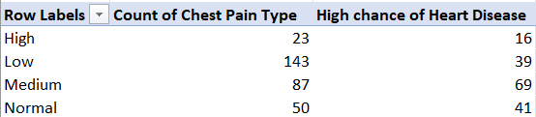


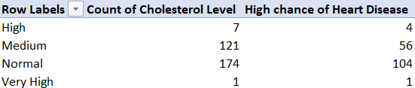
Data Collection and Preparation:-

Slide 6
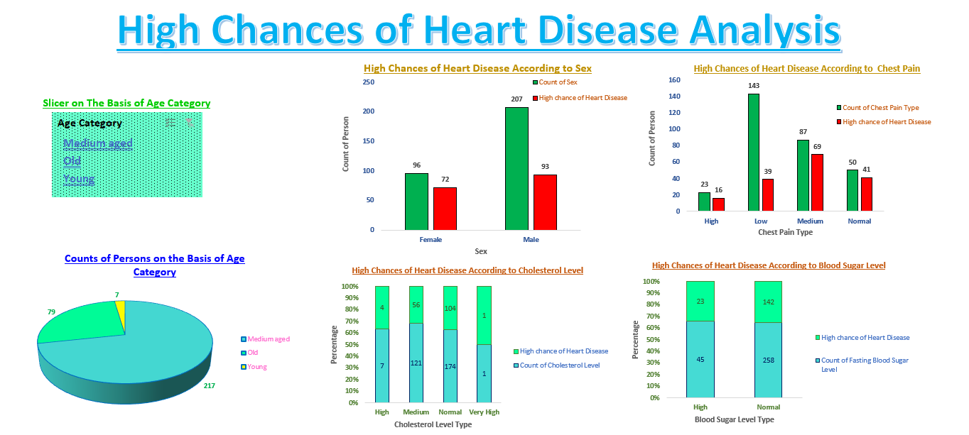
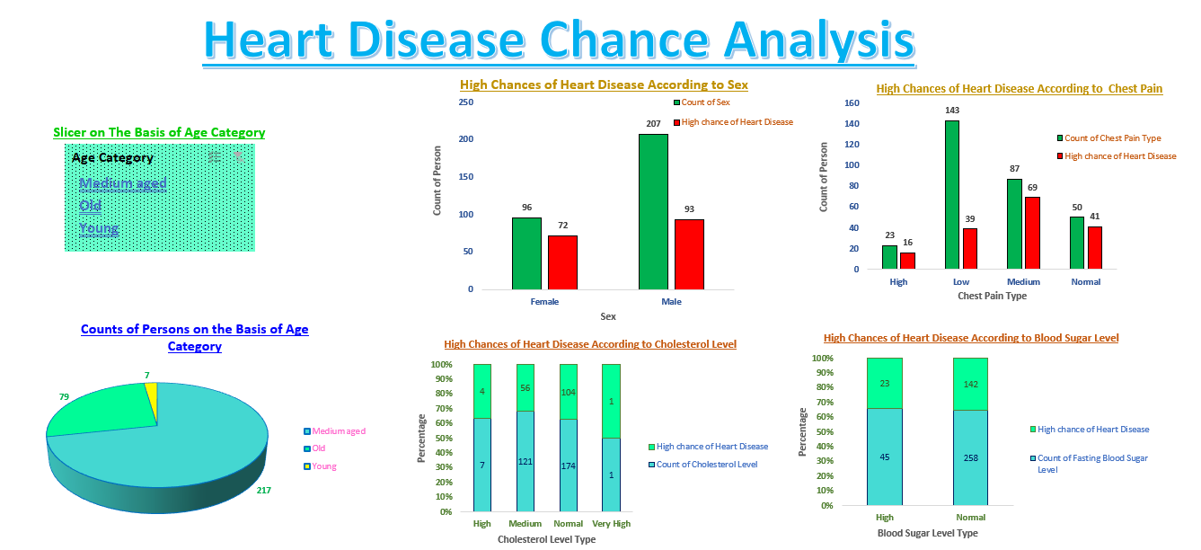
Overall Data:-

Slide 7
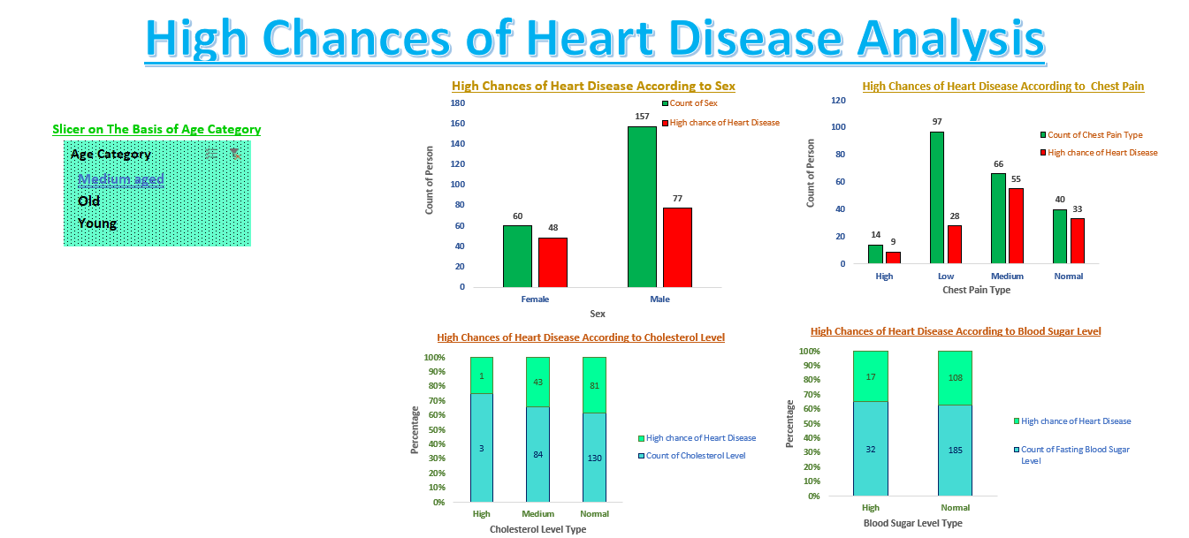
Data of Medium Aged Person:-

Slide 8
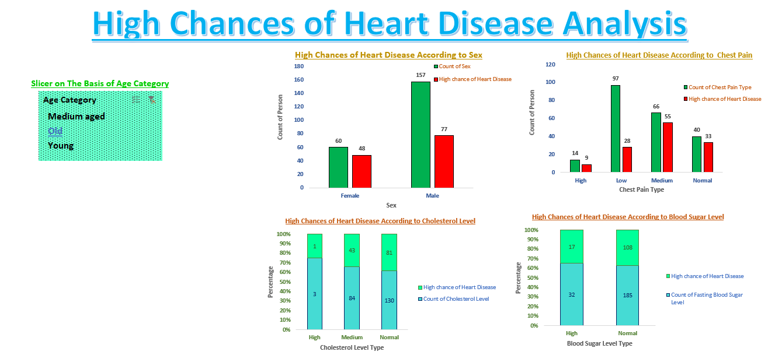
Data of Old Person:-

Slide 9
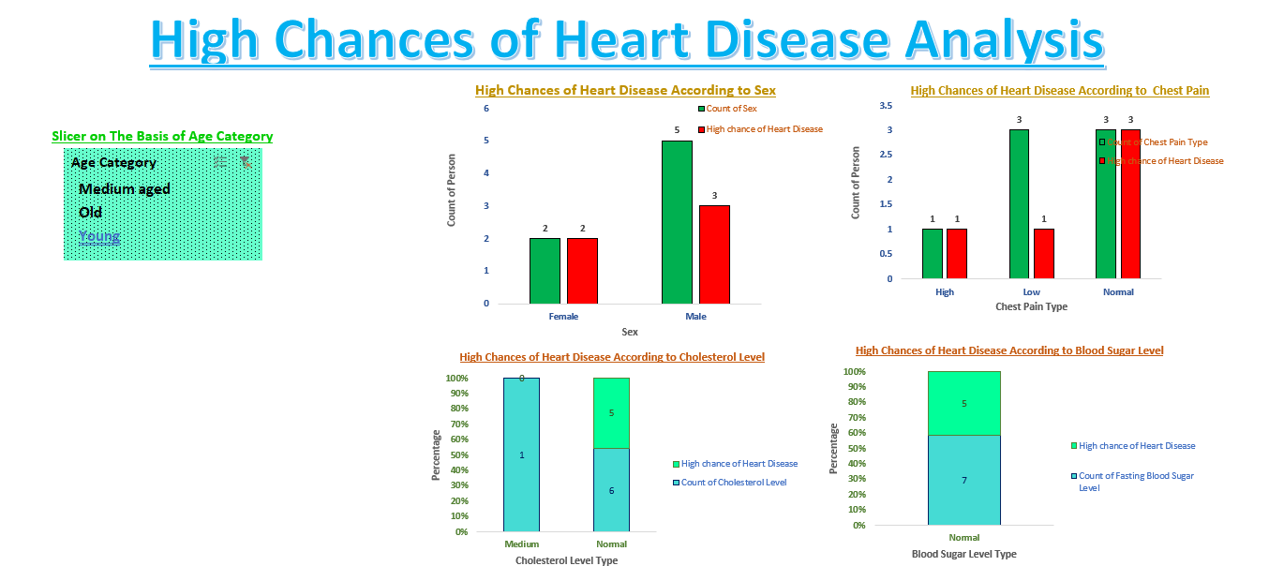
Data of Young Person:-

Slide 10
Conclusion:
By examining critical health indicators such as sex, cholesterol levels, blood pressure, and other relevant factors, this project aims to provide valuable insights into the risk of heart disease. The objective is to empower healthcare professionals and stakeholders with data-driven tools and knowledge to identify high-risk individuals early. The findings and recommendations derived from this analysis can significantly contribute to improving preventive healthcare measures, enhancing patient outcomes, and supporting long-term strategies for reducing the prevalence of heart disease.

Slide 11
Thank You
PRESENTATION BY : SAIKAT PRADHAN

